Slide 1
Training data (1/22~ 3/31)
Test data (3/19 ~ 4/30)
Training data (1/22~ 3/31)
Test data (3/19 ~ 4/30)
…
Training data (1/22~ 3/31)
Test data (3/19 ~ 4/30)
1/22/2020 ~ 3/31/2020 (70 개)
3/19/2020 ~ 4/30/2020 (43개)

Slide 2
23501 Guam US 1/22/2020 0 0
23502 Guam US 1/23/2020 0 0
23503 Guam US 1/24/2020 0 0
23504 Guam US 1/25/2020 0 0
23505 Guam US 1/26/2020 0 0
23506 Guam US 1/27/2020 0 0
23507 Guam US 1/28/2020 0 0
23508 Guam US 1/29/2020 0 0
23509 Guam US 1/30/2020 0 0
23510 Guam US 1/31/2020 0 0
23511 Guam US 2/1/2020 0 0
23512 Guam US 2/2/2020 0 0
23513 Guam US 2/3/2020 0 0
23514 Guam US 2/4/2020 0 0
23515 Guam US 2/5/2020 0 0
23516 Guam US 2/6/2020 0 0
23517 Guam US 2/7/2020 0 0
23518 Guam US 2/8/2020 0 0
23519 Guam US 2/9/2020 0 0
23520 Guam US 2/10/2020 0 0
23521 Guam US 2/11/2020 0 0
23522 Guam US 2/12/2020 0 0
23523 Guam US 2/13/2020 0 0
23524 Guam US 2/14/2020 0 0
23525 Guam US 2/15/2020 0 0
23526 Guam US 2/16/2020 0 0
23527 Guam US 2/17/2020 0 0
23528 Guam US 2/18/2020 0 0
23529 Guam US 2/19/2020 0 0
23530 Guam US 2/20/2020 0 0
23531 Guam US 2/21/2020 0 0
23532 Guam US 2/22/2020 0 0
23533 Guam US 2/23/2020 0 0
23534 Guam US 2/24/2020 0 0
23535 Guam US 2/25/2020 0 0
23536 Guam US 2/26/2020 0 0
23537 Guam US 2/27/2020 0 0
23538 Guam US 2/28/2020 0 0
23539 Guam US 2/29/2020 0 0
23540 Guam US 3/1/2020 0 0
23541 Guam US 3/2/2020 0 0
23542 Guam US 3/3/2020 0 0
23543 Guam US 3/4/2020 0 0
23544 Guam US 3/5/2020 0 0
23545 Guam US 3/6/2020 0 0
23546 Guam US 3/7/2020 0 0
23547 Guam US 3/8/2020 0 0
23548 Guam US 3/9/2020 0 0
23549 Guam US 3/10/2020 0 0
23550 Guam US 3/11/2020 0 0
23551 Guam US 3/12/2020 0 0
23552 Guam US 3/13/2020 0 0
23553 Guam US 3/14/2020 0 0
23554 Guam US 3/15/2020 3 0
23555 Guam US 3/16/2020 3 0
23556 Guam US 3/17/2020 3 0
23557 Guam US 3/18/2020 5 0
23558 Guam US 3/19/2020 12 0
23559 Guam US 3/20/2020 14 0
23560 Guam US 3/21/2020 15 0
23561 Guam US 3/22/2020 27 1
23562 Guam US 3/23/2020 29 1
23563 Guam US 3/24/2020 32 1
23564 Guam US 3/25/2020 37 1
23565 Guam US 3/26/2020 45 1
23566 Guam US 3/27/2020 51 1
23567 Guam US 3/28/2020 55 1
23568 Guam US 3/29/2020 56 1
23569 Guam US 3/30/2020 58 1
23570 Guam US 3/31/2020 69 2
Train
Test
1/22/2020 ~ 3/31/2020 (70 개)
3/19/2020 ~ 4/30/2020 (43개)
Training data

Slide 3
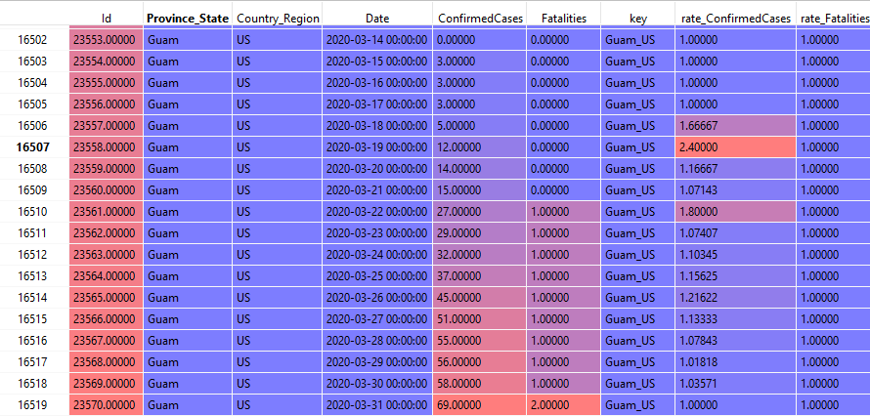
Prediction Process (It uses pretrained models from day 1 to 30)
lgb.LGBMRegressor
lightgbm
# model: lightgbm.basic.Booster # {'objective': 'rmse', # 'metric': 'rmse', # 'boosting': 'gbdt', # 'learning_rate': 0.01, # 'drop_rate': 0.01, # 'skip_drop': 0.6, # 'uniform_drop': True, # 'verbose': -1, # 'num_leaves': 30, # 'bagging_fraction': 0.9, # 'bagging_freq': 1, # 'bagging_seed': 1412, # 'feature_fraction': 0.8, # 'feature_fraction_seed': 1412, # 'min_data_in_leaf': 10, # 'max_bin': 100, # 'max_depth': 20, # 'reg_alpha': 1, # 'lambda_l2': 10, # 'num_threads': 6 # }
Train
Test
1/22/2020 ~ 3/31/2020 (70 개)
3/19/2020 ~ 4/30/2020 (43개)
총 30일치 Prediction Model Lightgbm 보유

Slide 4
페이퍼
1
2
3
방법 1
Feature engineering 1
Feature engineering 2
Feature engineering 3
ML 1
ML 2
ML 3
융합 1
융합 2
융합 3
방법 2
Feature engineering 1
ML 1
ML 2
ML 3
융합 1
융합 2
융합 3

Slide 5
Features (X variables)
['lag_confirmed_rate1', 'lag_confirmed_rate2', 'lag_confirmed_rate3', 'lag_confirmed_rate4', 'lag_confirmed_rate5', 'lag_confirmed_rate6', 'lag_confirmed_rate7', 'lag_confirmed_rate8', 'lag_confirmed_rate9', 'lag_confirmed_rate10', 'lag_confirmed_rate11', 'lag_confirmed_rate12', 'lag_confirmed_rate13', 'lag_confirmed_rate14', 'lag_confirmed_rate15', 'lag_confirmed_rate16', 'lag_confirmed_rate17', 'lag_confirmed_rate18', 'lag_confirmed_rate19', 'lag_confirmed_rate20’,
'days_ago_confirmed_count_1', 'days_ago_confirmed_count_10', 'days_ago_confirmed_count_100’,
'ma3_rate_confirmed1', 'ma3_rate_confirmed2', 'ma3_rate_confirmed3', 'ma3_rate_confirmed4', 'ma3_rate_confirmed5', 'ma3_rate_confirmed6', 'ma3_rate_confirmed7', 'ma3_rate_confirmed8', 'ma3_rate_confirmed9', 'ma3_rate_confirmed10', 'ma3_rate_confirmed11', 'ma3_rate_confirmed12', 'ma3_rate_confirmed13', 'ma3_rate_confirmed14', 'ma3_rate_confirmed15', 'ma3_rate_confirmed16', 'ma3_rate_confirmed17', 'ma3_rate_confirmed18', 'ma3_rate_confirmed19', 'ma3_rate_confirmed20’,
'std3_rate_confirmed1', 'std3_rate_confirmed2', 'std3_rate_confirmed3', 'std3_rate_confirmed4', 'std3_rate_confirmed5', 'std3_rate_confirmed6', 'std3_rate_confirmed7', 'std3_rate_confirmed8', 'std3_rate_confirmed9', 'std3_rate_confirmed10', 'std3_rate_confirmed11', 'std3_rate_confirmed12', 'std3_rate_confirmed13', 'std3_rate_confirmed14', 'std3_rate_confirmed15', 'std3_rate_confirmed16', 'std3_rate_confirmed17', 'std3_rate_confirmed18', 'std3_rate_confirmed19', 'std3_rate_confirmed20’,
'ewma3_rate_confirmed1', 'ewma3_rate_confirmed2', 'ewma3_rate_confirmed3', 'ewma3_rate_confirmed4', 'ewma3_rate_confirmed5', 'ewma3_rate_confirmed6', 'ewma3_rate_confirmed7', 'ewma3_rate_confirmed8', 'ewma3_rate_confirmed9', 'ewma3_rate_confirmed10', 'ewma3_rate_confirmed11', 'ewma3_rate_confirmed12', 'ewma3_rate_confirmed13', 'ewma3_rate_confirmed14', 'ewma3_rate_confirmed15', 'ewma3_rate_confirmed16', 'ewma3_rate_confirmed17', 'ewma3_rate_confirmed18', 'ewma3_rate_confirmed19', 'ewma3_rate_confirmed20’,
'ma5_rate_confirmed1', 'ma5_rate_confirmed2', 'ma5_rate_confirmed3', 'ma5_rate_confirmed4', 'ma5_rate_confirmed5', 'ma5_rate_confirmed6', 'ma5_rate_confirmed7', 'ma5_rate_confirmed8', 'ma5_rate_confirmed9', 'ma5_rate_confirmed10', 'ma5_rate_confirmed11', 'ma5_rate_confirmed12', 'ma5_rate_confirmed13', 'ma5_rate_confirmed14', 'ma5_rate_confirmed15', 'ma5_rate_confirmed16', 'ma5_rate_confirmed17’...총 468 개 features
학습 방법
모델
1
2
...
30 개
70 개 이전 날짜 데이터 이용
69 개 이전 날짜 데이터 이용
Day 1 예측
68 개 이전 날짜 데이터 이용
Day 1 예측
30 개 모델

Slide 6
Feature Engineering (time window)
방법 1
X variables
Y variable
* 개 이전 날짜 데이터 이용
Day 1 예측
모델 1
* 개 이전 날짜 데이터 이용
Day 2 예측
모델 2
* 개 이전 날짜 데이터 이용
Day 3 예측
모델 3
Xt-*, Xt-3,Xt-2,Xt-1
방법 2
30 개 이전 날짜 데이터 이용
Day 1 예측
모델 1
30 개 이전 날짜 데이터 이용
Day 2 예측
모델 2
30 개 이전 날짜 데이터 이용
Day 3 예측
모델 3
Xt-4, Xt-3,Xt-2,Xt-1
날씨t-4, 날씨t-3, 날씨t-2, 날씨t-1, 날씨t
4, *, 1
Kaz
방법 3
현재 날짜
Day 1 예측
모델 1
현재 날짜
Day 2 예측
모델 2
현재 날짜
Day 3 예측
모델 3
Xt-1

Slide 7
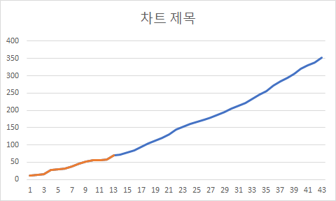
ConfirmedCases
12
14
15
27
29
32
37
45
51
55
56
58
69
72.6374332
77.34089641
84.44860222
93.47471534
103.2303105
111.8697917
120.4633771
130.4596388
145.0059312
152.4616504
159.8194503
165.9780573
172.627407
179.0736582
186.9978266
195.1601366
204.2231616
212.2605224
221.851169
233.3880931
245.6376568
256.4586638
271.4176492
283.9110009
294.5382401
305.7467445
319.6921041
330.6765401
339.2575769
352.3351359
Train
Test
1/22/2020 ~ 3/31/2020 (70 개)
3/19/2020 ~ 4/30/2020 (43개)

Slide 8
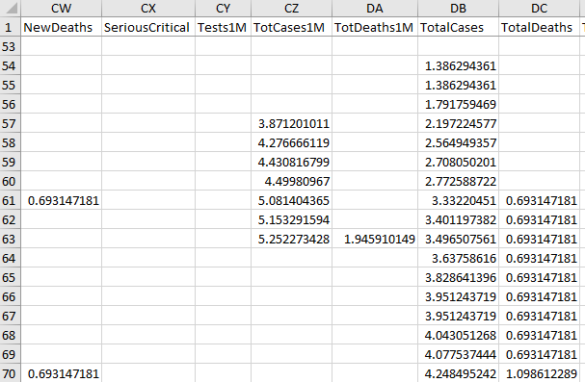

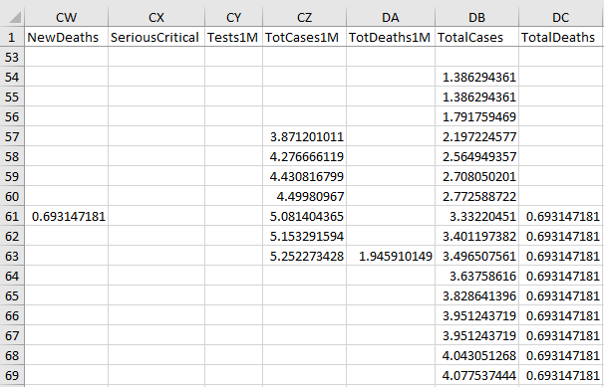

X Variables
Y Variable
Model 1
Model 2
삭제 70
Y 데이터는
이전 날짜로 이동 ?

